Slide 1
Problems in Detect & Avoid: Explained as a story Incremental problem definition
Notes:
I will tell you nice introduction story for Obstacle avoidance

Slide 2
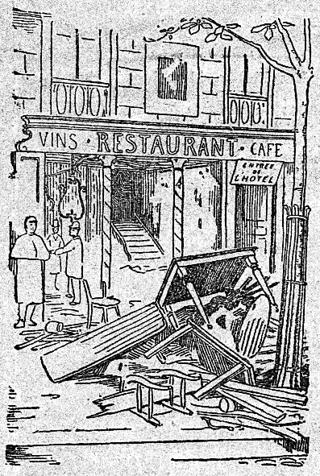

<-
<-
<-
How this gentleman
gets
into the Fine Restaurant
[1]https://commons.wikimedia.org/wiki/File:Le_restaurant_V%C3%A9ry_-_ext.png
[2]https://commons.wikimedia.org/wiki/File:A_gentleman,_walking_towards_the_left_and_drawing_his_sword_from_the_sheath,_wearing_a_plumed_hat_and_boots_with_spurs_MET_DP829192.jpg
Notes:
The gentleman want to get into the fine restaurant

Slide 3
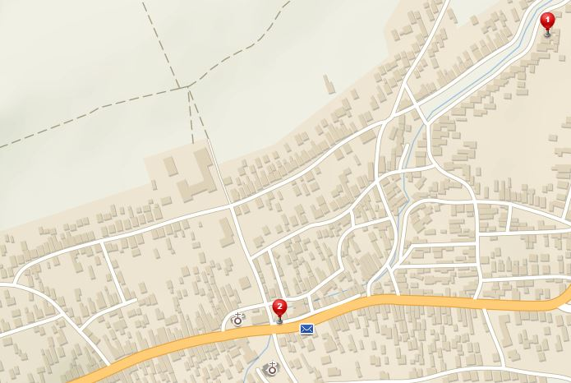
How to get to the fine restaurant ?
Östlichesburg
~ 1269 AD
Home
Restaurant
Notes:
There is a situation, Gentleman is at Home
Restaurant is near city center

Slide 4
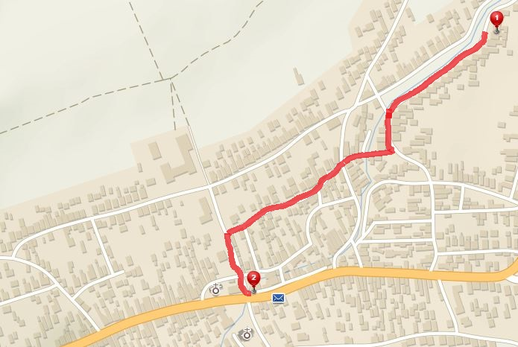
No problem, I know a map of my surroundings
[P1] Path planning problem:
1. Get MAP
2. PLAN then EXECUTE the PATH
Path to restaurant
Notes:
Path planning problem is introduced,
Plan and Execute a Path to Restaurant,
Really simple, nobody is on streets, I have precise and correct information and map,
Now lets make a life harder

Slide 5
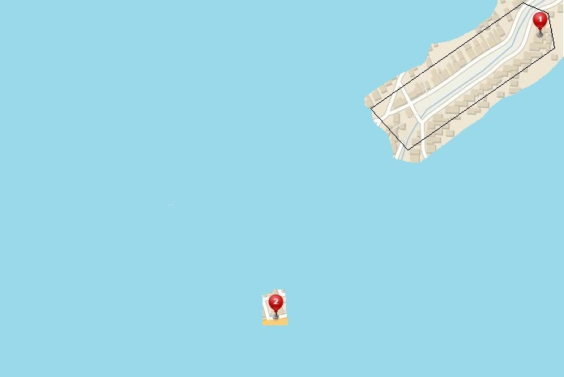
Forget your map, know the restaurant location
[P1] Evolving world:
1. Obtaining knowledge over time
2. Continous Decision Making
My Position
Field of Vision
GOAL
Notes:
There is a challenge (problem), Map forgotten,
Possibilities to see all of situation are limited.
We still know where is GOAL of our Journey.
There Is a Evolving World Challenge,
Need to make decisions with limited sensory reading is inevitable

Slide 6
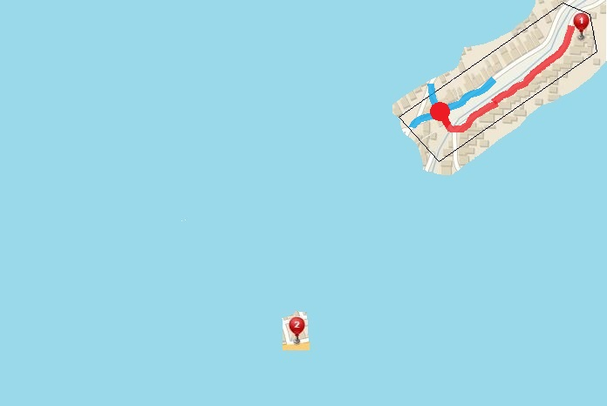
I get to the first intersection, now what ?
Decision Point:
Way 3
Way 2
Way 1
Decision point
Passed trajectory
GOAL
Apply COST Function
In
Decisions
Notes:
Get to the end of charted territory, at the DECISION POINT
Crossroad has three ways,
We chose one which gets us closest to our GOAL

Slide 7
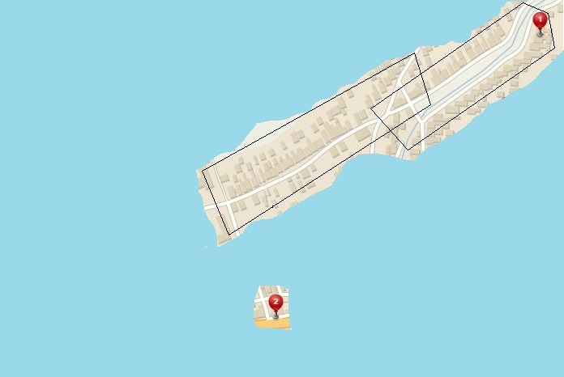
Look around, get know to your surroundings
This PATH can get me Closer
GOAL
Notes:
Now new patch of the territory has been revealed

Slide 8
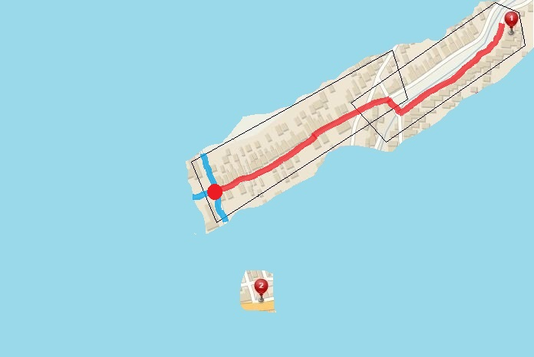
Walk a little more, get closer to the Restaurant
Rinse and repeat
Way 3
Passed trajectory
Way 2
Decision point
Way 1
GOAL
Notes:
Now Rinse and Repeat,
Same as before we get to Decision Point,
Three ways lies ahead only one leads to Goal

Slide 9
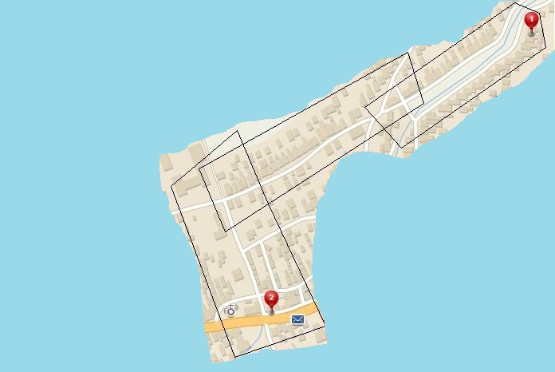
Now Gentleman can see the Restaurant
GET to the Restaurant
GOAL
I can see the way
to the Restaurant
Notes:
Now we take the right way,
We can see a Goal of our journey …

Slide 10
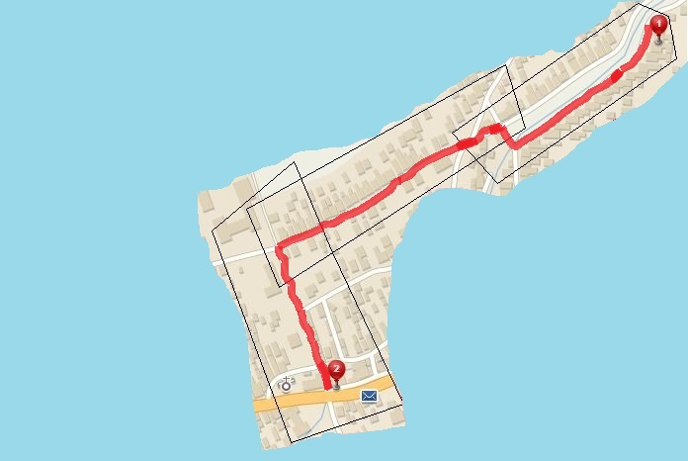
Enjoy a Pint
[P1] Evolving world:
SEMI-Optimal navigation to GOAL
Less optimal than [1]
Your destination is at the right side of the road
Notes:
Just Reach it and we are fine,
Evolving world challenge has been passes,
The Path was not as optimal as in case when we had a map, but we did it
Now lets make life harder again.

Slide 11
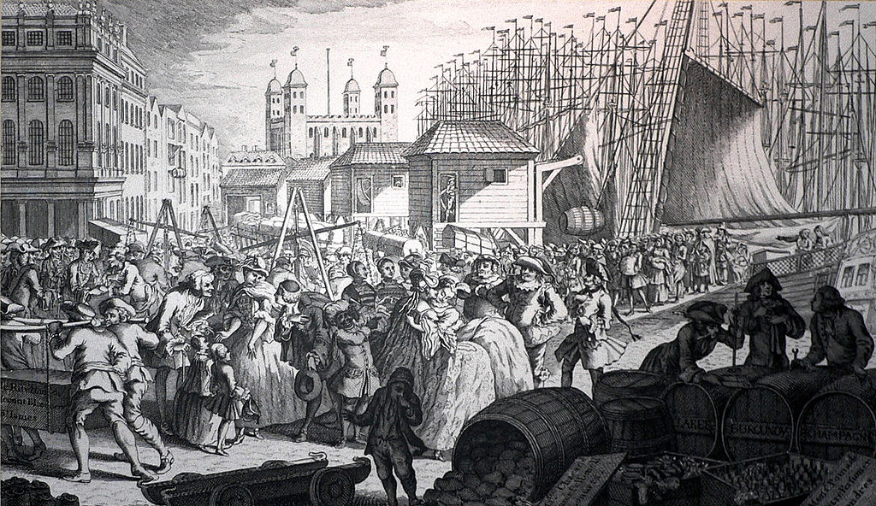

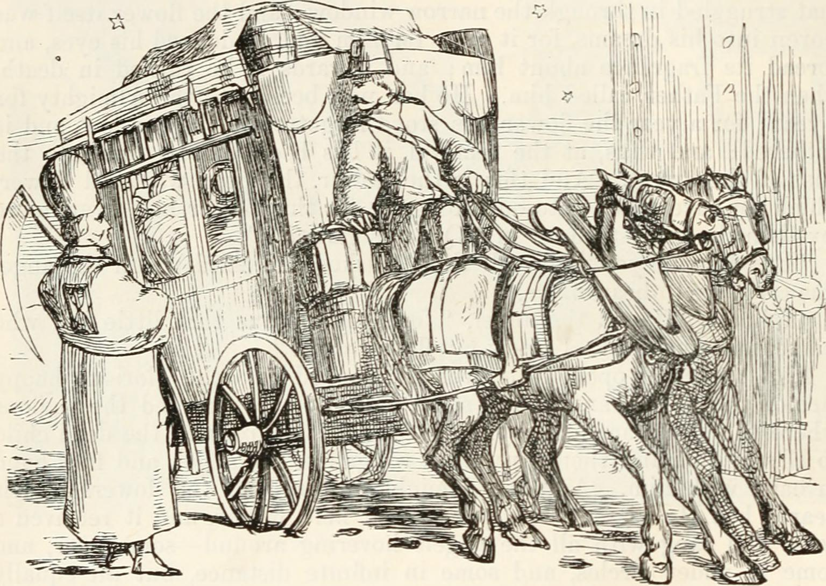
You are NOT alone on the streets !
[P3] Adversarial:
You need to avoid:
Carriages and Other people
You can hurt others !
[P3] Adversarial:
Reactive obstacle avoidance
Ingredients:
Intruder Position
Intruder Velocity
Own position and velocity
Notes:
You are not alone on streets nor in the Airspace.
There are Adversaries, people and Carriages, whom wants to take your sweet spot on the road.
You can use your cat like reflexes to avoid them, you just need to know:
Their position and heading velocity
Your own intentions
Now lets make life even harder,

Slide 12
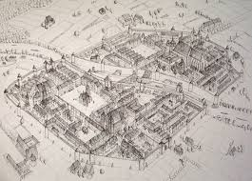
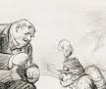
Multiple source of information – Data Fusion
[P3] Data fusion:
So much Information …
So many Whispers …
Need Validation …
Much Verification …
[P3] Data Fusion:
Decisions under uncertainty
Determine what is truth
Consider all information
Rank your sources worth
Notes:
You bought a new map, which is not very precise, but still reliable,
You heard many rumors and much more stuff from officials,
You need to clean your head to make a right choice, what is true what is good,
Do not worry my friend Data Fusion is here to help

Slide 13
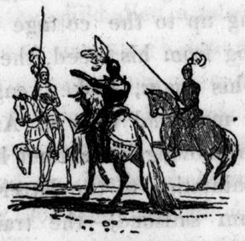

Vigilantes & Grannies – Static restriction areas
[P3] Static restrictions:
Vigilantes will kill you …
Grannies will tell your grandmother ….
[P3] Static restrictions:
You can break it, but you
will pay
TERRIBLE PRICE !
Try to avoid all restricted areas
Notes:
There is a space which is occupied by various groups,
One are kind like Grannies, whom only tell your Grand mother that you get into Fine restaurant
Other are not so kind, like Vigilante Knights which will kill you on the spot (What did you expected from dark ages ?)

Slide 14
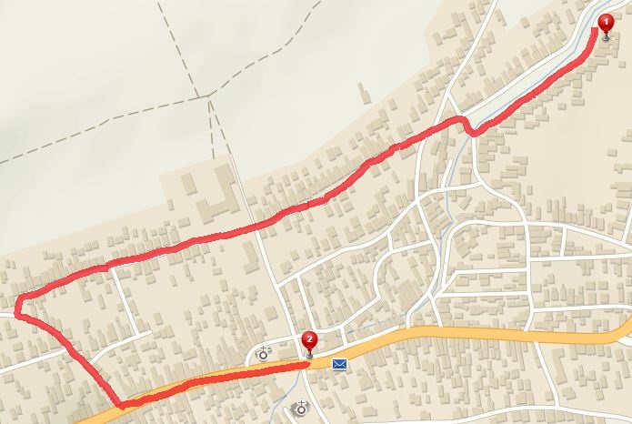
Try to avoid static restrictions areas !
[5] Static restrictions:
Avoid them all !
Vigilante
Grannies
Notes:
Let see the situation on the map, The occupied territory is marked for each group,
The large detour was taken to avid both of them.
Now every problem in Avoidance topic should be addressed right ?
How about weather ?

Slide 15
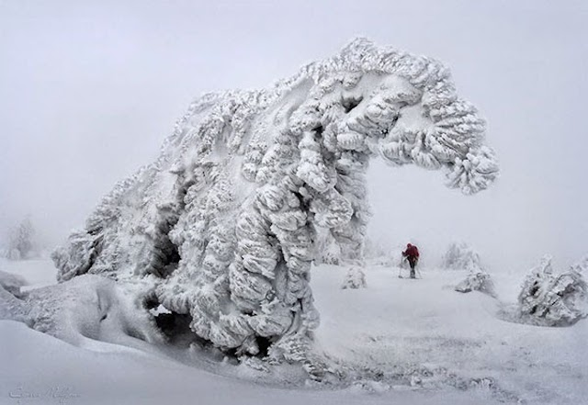

How about weather ?
[P4] Weather:
Östlichesburg winter very harsh,
On the other hand,
Östlichesburg summer even Harsher
[P4] Weather:
Harsh Weather Avoid NOW !
Maybe you will need to break some restrictions
Notes:
Weather is bad for our skin, so we try to avoid bad weather,

Slide 16
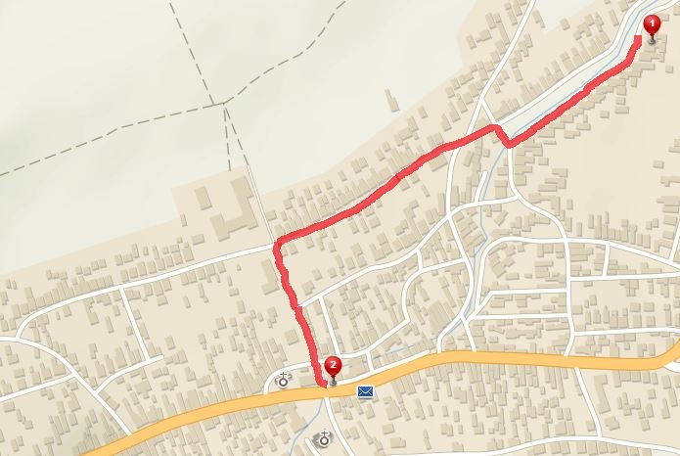
Rather get caught, than catching cold …
[P4] Weather:
You will avoid Snowstorm,
But you will answer to Grandmother call …
Snowstorm
I will explain somehow…
Vigilante
Heatwave
Grannies
Notes:
Dark ages weather was very harsh and very localized,
We have
snowstorm on the left
Heatwave on the right
Do not worry Grannies and Vigilante is still there, so what now …
We need to break some restrictions and avoid harsher conditions …
There is one more thing to address …

Slide 17
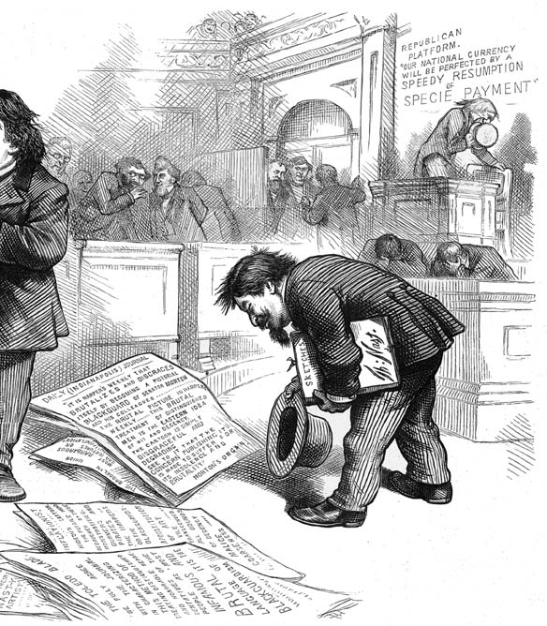
Stick to the rules !
[P5] Rules:
Obey rules while walking
[P5] Rules:
Stick to Written and unwritten rules …
Necessity
for integration into traffic,
society,
air space
Notes:
You just need to stick to the rules,
Society Norm, traffic regulations, airspace rules and so on ….

Slide 18
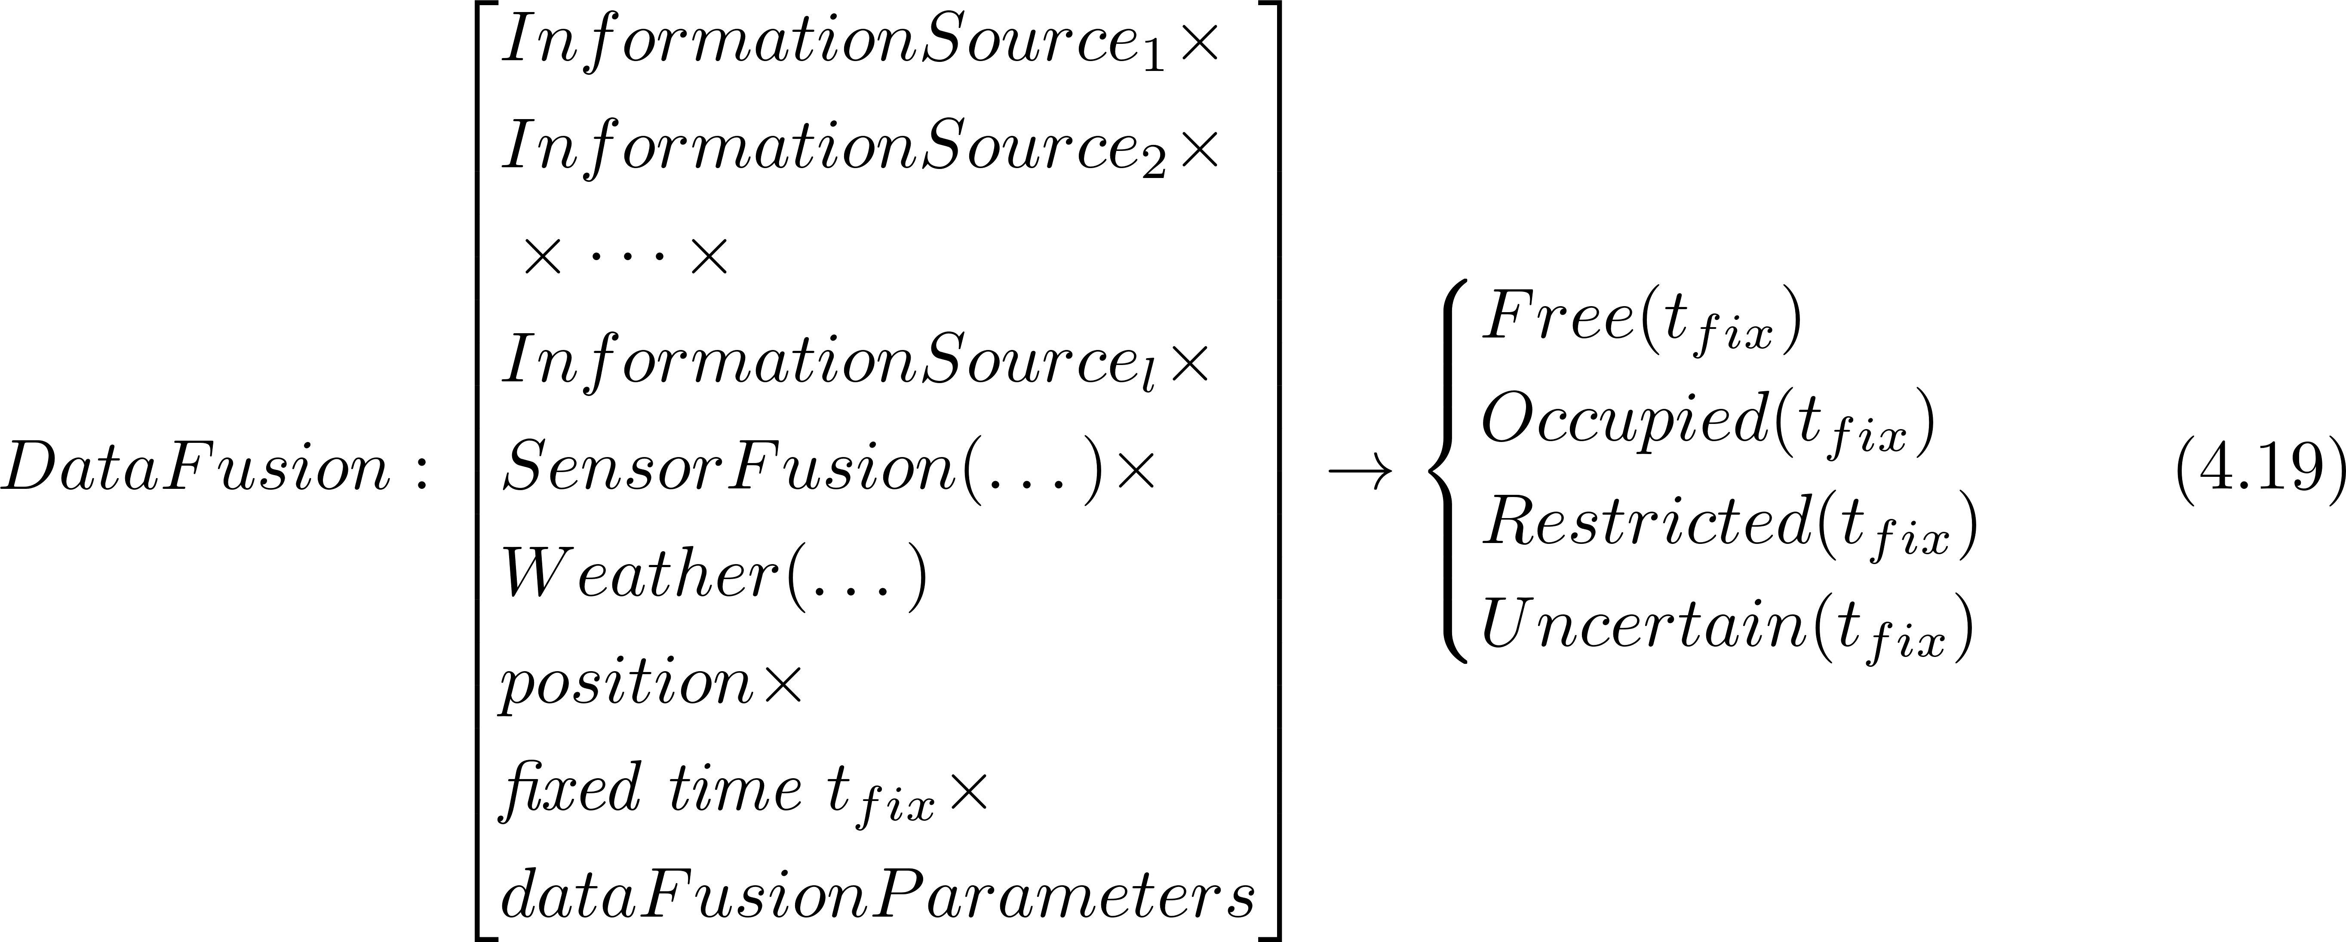
Formal problem specification 1/2
The UAS is operating in space classified into four distinctive subsets:
The space classification is coming from data fusion procedure:

Slide 19
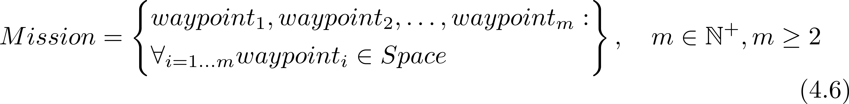
Formal problem specification 2/2
UAS will fly a Mission given as ordered set of waypoints:
The goal is to have path satisfying:
Under the assumptions:
Filtered sensor reading are available.
There are no moving obstacles (intruders) [Relaxed P3]
The movement takes place in unrestricted airspace [Relaxed P5]
The mission consist of a set of reachable waypoints
The UAS is moving with constant velocity [Relaxed P5]

Slide 20
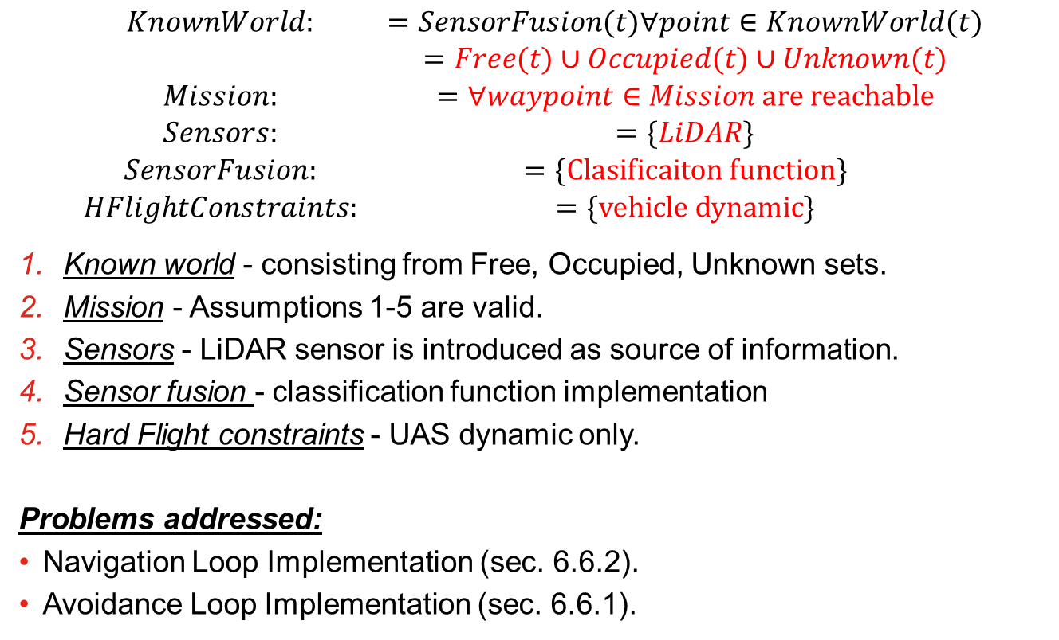
Incremental problem definition: [P1] Basic Avoidance
$$\begin{matrix}KnownWorld: & =SensorFusion(t)∀point∈KnownWorld(t) \\ & =Free(t)∪Occupied(t)∪Unknown(t) \\ Mission: & =∀waypoint∈Mission are reachable \\ Sensors: & =\{LiDAR\} \\ SensorFusion: & =\{Clasificaiton function\} \\ HFlightConstraints: & =\{vehicle dynamic\}\end{matrix}$$
Known world - consisting from Free, Occupied, Unknown sets.
Mission - Assumptions 1-5 are valid.
Sensors - LiDAR sensor is introduced as source of information.
Sensor fusion - classification function implementation
Hard Flight constraints - UAS dynamic only.
Problems addressed:
Navigation Loop Implementation (sec. 6.6.2).
Avoidance Loop Implementation (sec. 6.6.1).

Slide 21
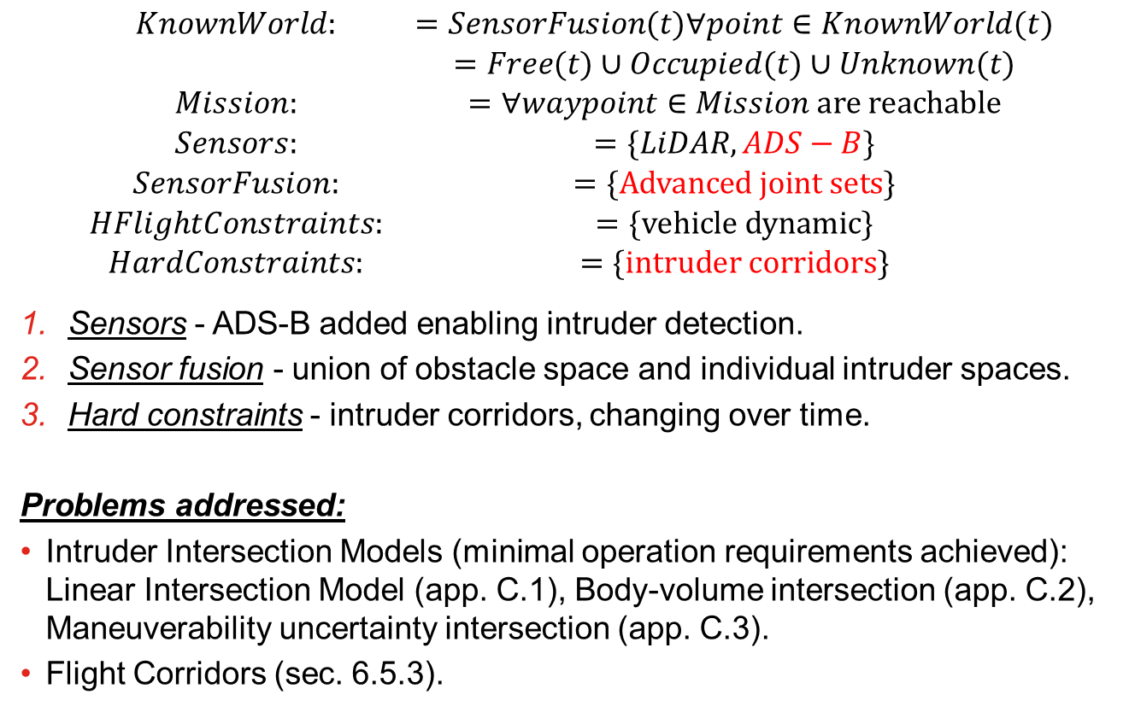
Incremental problem definition: [P2] Intruders Introduction
$$\begin{matrix}KnownWorld: & =SensorFusion(t)∀point∈KnownWorld(t) \\ & =Free(t)∪Occupied(t)∪Unknown(t) \\ Mission: & =∀waypoint∈Mission are reachable \\ Sensors: & =\{LiDAR,ADS−B\} \\ SensorFusion: & =\{Advanced joint sets\} \\ HFlightConstraints: & =\{vehicle dynamic\} \\ HardConstraints: & =\{intruder corridors\}\end{matrix}$$
Sensors - ADS-B added enabling intruder detection.
Sensor fusion - union of obstacle space and individual intruder spaces.
Hard constraints - intruder corridors, changing over time.
Problems addressed:
Intruder Intersection Models (minimal operation requirements achieved): Linear Intersection Model (app. C.1), Body-volume intersection (app. C.2), Maneuverability uncertainty intersection (app. C.3).
Flight Corridors (sec. 6.5.3).

Slide 22
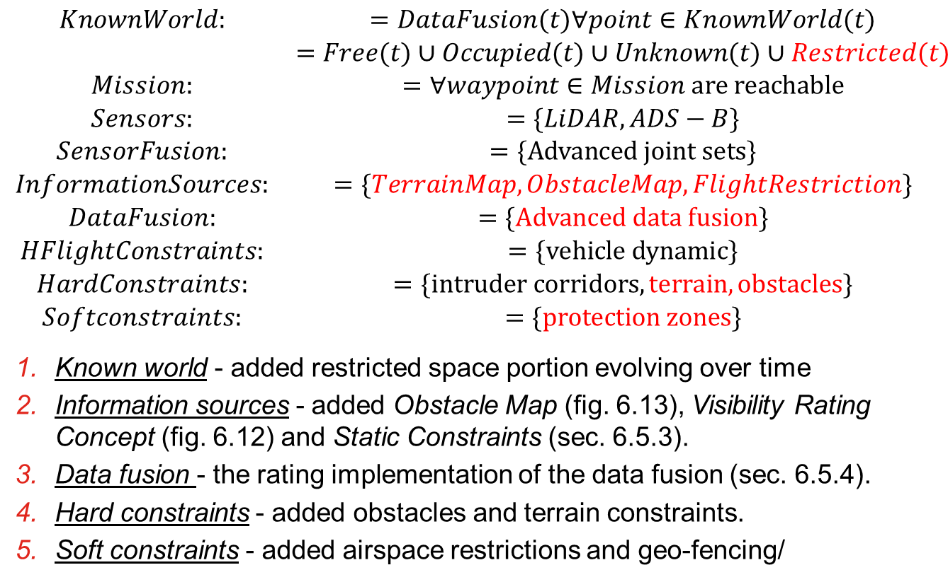
Incremental problem definition: [P3] Static restrictions
$$\begin{matrix}KnownWorld: & =DataFusion(t)∀point∈KnownWorld(t) \\ & =Free(t)∪Occupied(t)∪Unknown(t)∪Restricted(t) \\ Mission: & =∀waypoint∈Mission are reachable \\ Sensors: & =\{LiDAR,ADS−B\} \\ SensorFusion: & =\{Advanced joint sets\} \\ InformationSources: & =\{TerrainMap,ObstacleMap,FlightRestriction\} \\ DataFusion: & =\{Advanced data fusion\} \\ HFlightConstraints: & =\{vehicle dynamic\} \\ HardConstraints: & =\{intruder corridors,terrain,obstacles\} \\ Softconstraints: & =\{protection zones\}\end{matrix}$$
Known world - added restricted space portion evolving over time
Information sources - added Obstacle Map (fig. 6.13), Visibility Rating Concept (fig. 6.12) and Static Constraints (sec. 6.5.3).
Data fusion - the rating implementation of the data fusion (sec. 6.5.4).
Hard constraints - added obstacles and terrain constraints.
Soft constraints - added airspace restrictions and geo-fencing/

Slide 23
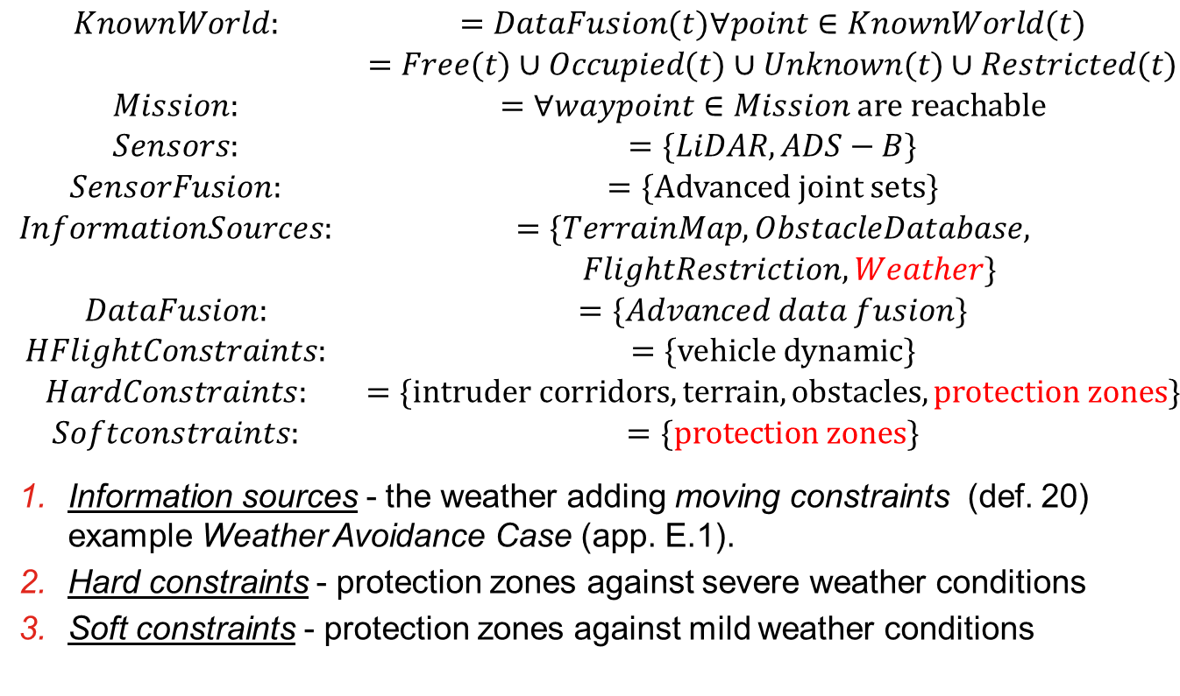
Incremental problem definition: [P4] Dynamic restrictions
$$\begin{matrix}KnownWorld: & =DataFusion(t)∀point∈KnownWorld(t) \\ & =Free(t)∪Occupied(t)∪Unknown(t)∪Restricted(t) \\ Mission: & =∀waypoint∈Mission are reachable \\ Sensors: & =\{LiDAR,ADS−B\} \\ SensorFusion: & =\{Advanced joint sets\} \\ InformationSources: & =\{TerrainMap,ObstacleDatabase, \\ & FlightRestriction,Weather\} \\ DataFusion: & =\{Advanced data fusion\} \\ HFlightConstraints: & =\{vehicle dynamic\} \\ HardConstraints: & =\{intruder corridors,terrain,obstacles, protection zones\} \\ Softconstraints: & =\{protection zones\}\end{matrix}$$
Information sources - the weather adding moving constraints (def. 20) example Weather Avoidance Case (app. E.1).
Hard constraints - protection zones against severe weather conditions
Soft constraints - protection zones against mild weather conditions

Slide 24
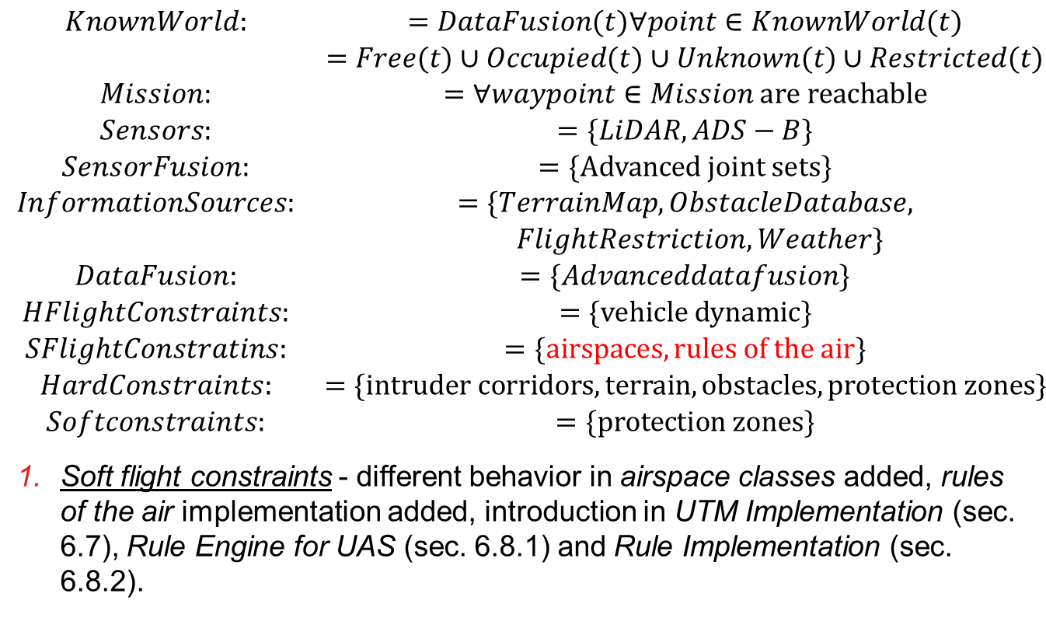
Incremental problem definition: [P5] Rules of the air
$$\begin{matrix}KnownWorld: & =DataFusion(t)∀point∈KnownWorld(t) \\ & =Free(t)∪Occupied(t)∪Unknown(t)∪Restricted(t) \\ Mission: & =∀waypoint∈Mission are reachable \\ Sensors: & =\{LiDAR,ADS−B\} \\ SensorFusion: & =\{Advanced joint sets\} \\ InformationSources: & =\{TerrainMap,ObstacleDatabase, \\ & FlightRestriction,Weather\} \\ DataFusion: & =\{Advanceddatafusion\} \\ HFlightConstraints: & =\{vehicle dynamic\} \\ SFlightConstratins: & =\{airspaces, rules of the air\} \\ HardConstraints: & =\{intruder corridors,terrain,obstacles, protection zones\} \\ Softconstraints: & =\{protection zones\}\end{matrix}$$
Soft flight constraints - different behavior in airspace classes added, rules of the air implementation added, introduction in UTM Implementation (sec. 6.7), Rule Engine for UAS (sec. 6.8.1) and Rule Implementation (sec. 6.8.2).

